Slide 1
Lab3 CUDA Basic
Oct, 2024 Parallel Programming

Slide 2
Overview
Platform guide
Tools
Assignment

Slide 3
Platform Guide

Slide 4
The GPU Cluster
Host: apollo-gpu.cs.nthu.edu.tw
Account & Password: Check your email

Slide 5

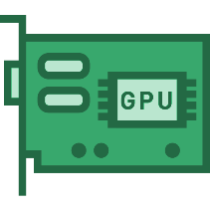


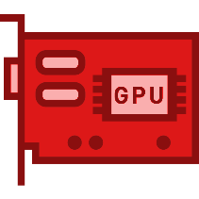
ssh nv-test
Frontend Server without GPU
(apollo-login)
Client
(Your computer)
srun -p nvidia nv-vm[1-7]
ssh apollo-gpu.cs.nthu.edu.tw
8 NVIDIA GPU VMs: each with 2x GTX 1080 GPUs 1 AMD GPU VM: with 3x AMD Instinct MI210 GPUs
srun -p amd amd-vm

Slide 6
The GPU Cluster
Login
apollo-login
CPU Only
nv-test
2x GTX1080
SSH
Slurm
nv-vm1
2x GTX1080
nv-vm2
2x GTX1080
nv-vm3
2x GTX1080
nv-vm4
2x GTX1080
nv-vm5
2x GTX1080
nv-vm6
2x GTX1080
nv-vm7
2x GTX1080
amd-vm
3x MI210

Slide 7
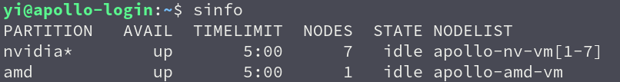
Job Scheduler
Slurm
Partitions: nvidia for NVIDIA GPUs (default), amd for AMD GPUs
Limitations
1GPU or 2 GPUs per Job
2 CPU cores per GPU (i.e. 1 GPU -> 2 cores, 2 GPUs -> 4 cores)
2 Jobs per User
Wall time: 5 minutes

Slide 8
Instructions to compile a CUDA program
Compile
nvcc -arch=sm_61 [other options] <inputfile>
e.g., nvcc cuda_code.cu -o cuda_executable
sm_61 is Compute Capability 6.1, which is what GTX 1080 supports
If you are using your own GPU, find your GPU’s compute capability here
If you have a Makefile, simply
make

Slide 9
Instructions to run a CUDA program
apollo-nv-test
ssh apollo-nv-test or ssh nv-test
If you want to specify which GPU to use.
export CUDA_VISIBLE_DEVICES=<gpu id>
eg. export CUDA_VISIBLE_DEVICES=1
eg. export CUDA_VISIBLE_DEVICES=0,1
apollo-nv-vm[1-7]
Slurm
Access gpus with the flag: --gres=gpu:<number of gpu>
eg. srun -n 1 --gres=gpu:1 ./executable
eg. srun -n 1 --gres=gpu:2 ./executable
If two GPUs are requested, they will be on the same node.

Slide 10
Practice
In this practice, try to run the deviceQuery
Steps:
cp -r /home/pp24/share/deviceQuery $HOME
cd $HOME/deviceQuery
nvcc deviceQuery.cpp -o deviceQuery
Run it
on apollo-nv-test
with Slurm scheduler on apollo-nv-vm[1-7]
How many CUDA cores on NVIDIA GTX 1080?

Slide 11
Tools

Slide 12
nvidia-smi
NVIDIA System Management Interface program
You can query details about
gpu type
gpu utilization
memory usage
temperature
clock rate
...

Slide 13
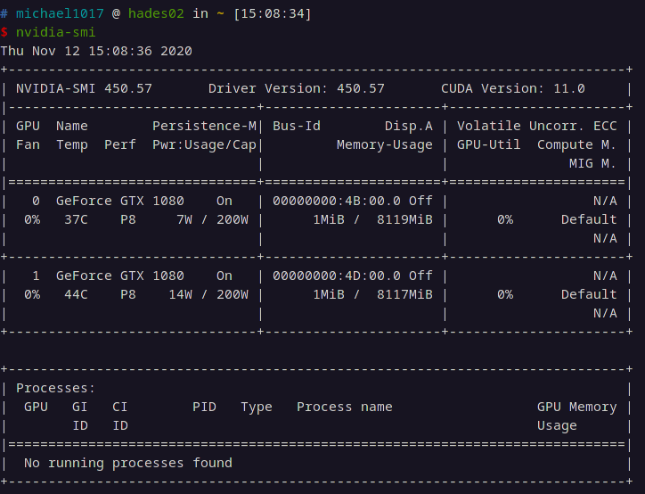
nvidia-smi example

Slide 14
cuda-memcheck
This tool checks memory errors of your program, and it also reports hardware exceptions encountered by the GPU. These errors may not cause program to crash, but they could result in unexpected program behavior and memory misusage.
Error types
cuda-memcheck

Slide 15
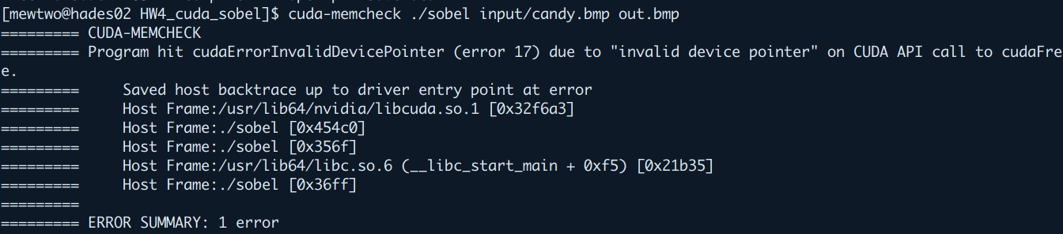
cuda-memcheck

Slide 16
cuda-gdb
cuda-gdb tutorial

Slide 17
nvprof
nvprof provide you feedback about how to optimize CUDA programs
nvprof <CUDA executable>
-o <FILE> to save result to a file
-i <FILE> to read result from a file

Slide 18
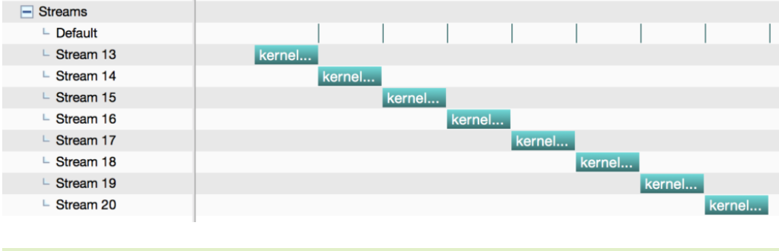
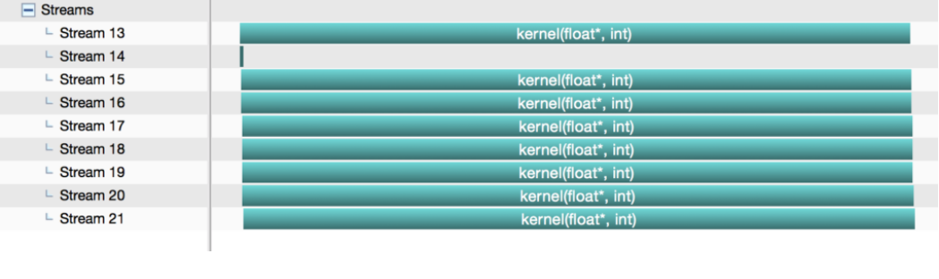
nvvp
nvvp-tutorial
GUI version of nvprof
Useful for the stream optimization
Timeline
nvvp is useful for checking the concurrency of stream

Slide 19
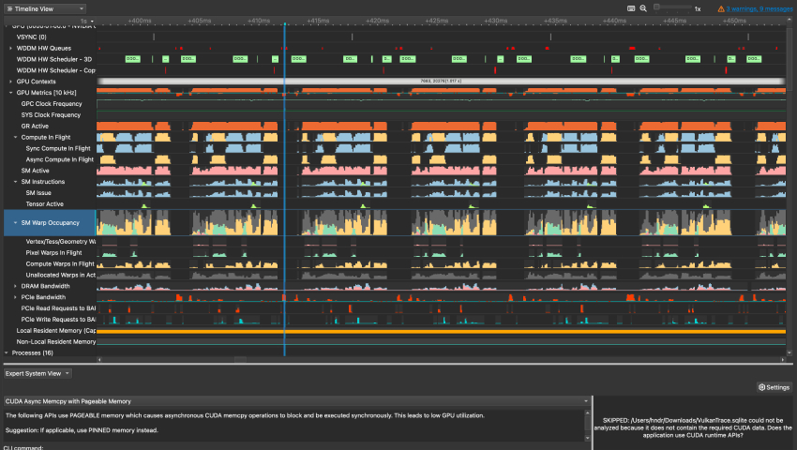
NSight Systems (nsys)
nsys profile -t cuda ...

Slide 20
Lab3 Assignment

Slide 21

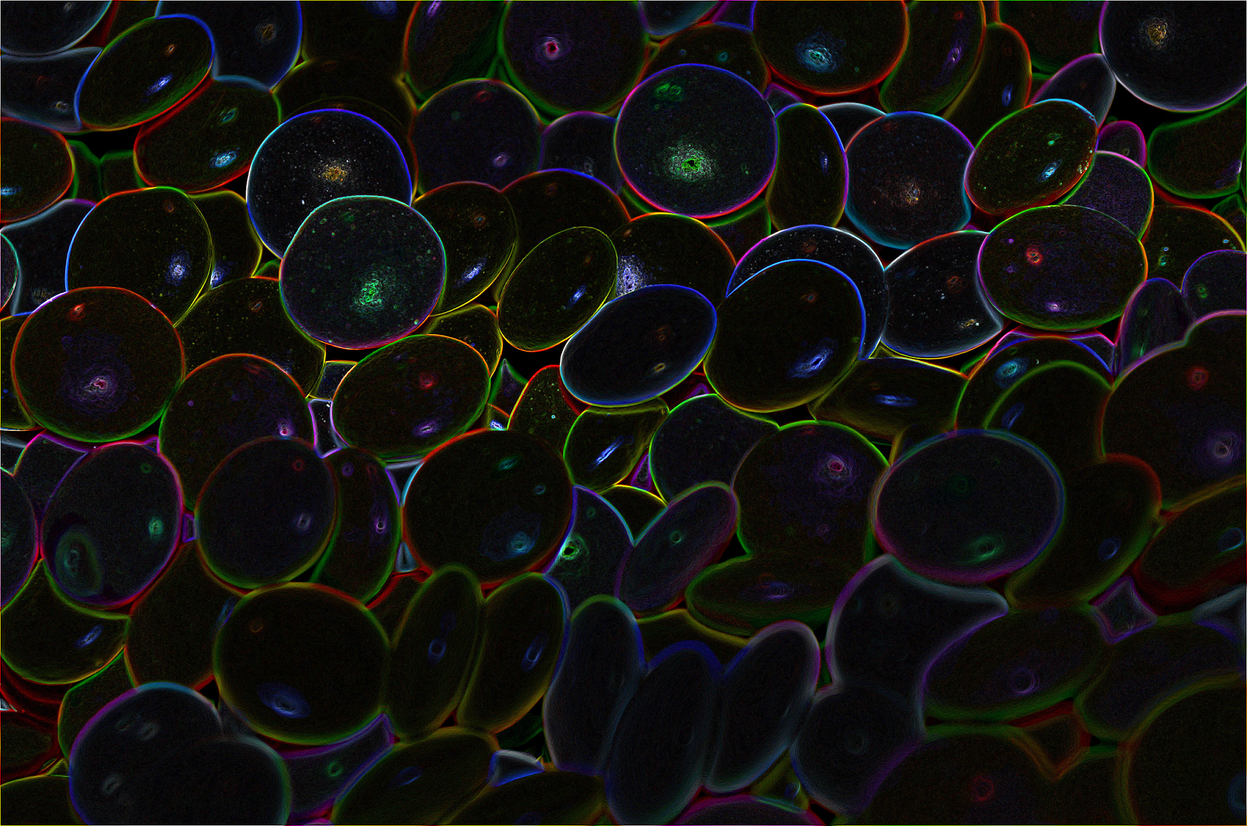
Problem Description
Edge Detection: Identifying points in a digital image at which the image brightness changes sharply

Slide 22
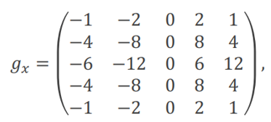
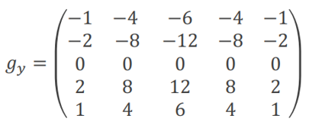
Sobel Operator
Used in image processing and computer vision, particularly within edge detection algorithms.
Uses two 3x3 filter matrix gx, gy which are convolved with the original image to calculate approximations of the derivatives - one for horizontal changes, and one for vertical.
In this lab, we use 5x5 kernels

Slide 23
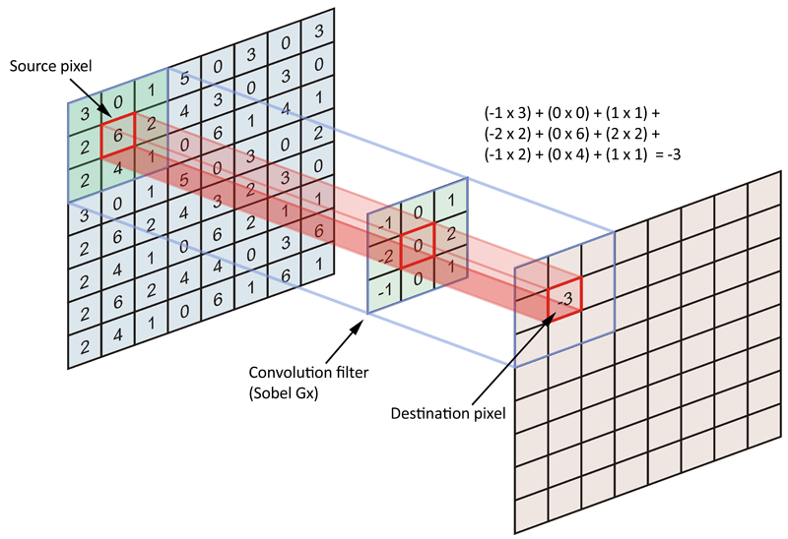
Convolution Calculation
Iterate through the width and height of the image
For each pixel, multiply the filter matrix with original image element-wisely and sum them up.
Credit: https://soubhihadri.medium.com/image-processing-best-practices-c-part-2-c0988b2d3e0c

Slide 24
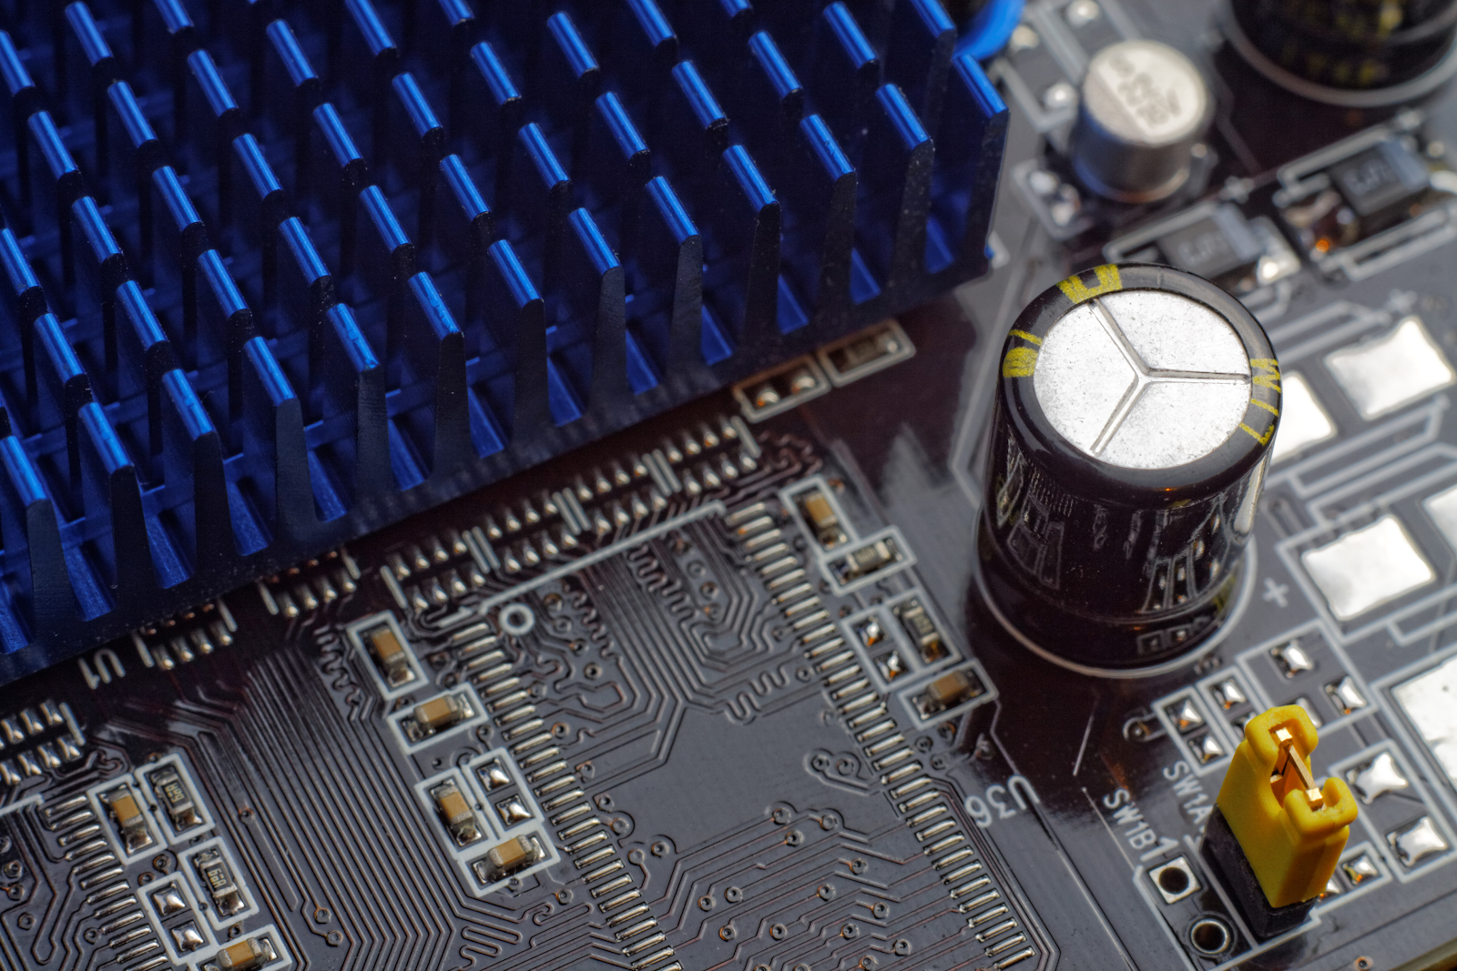
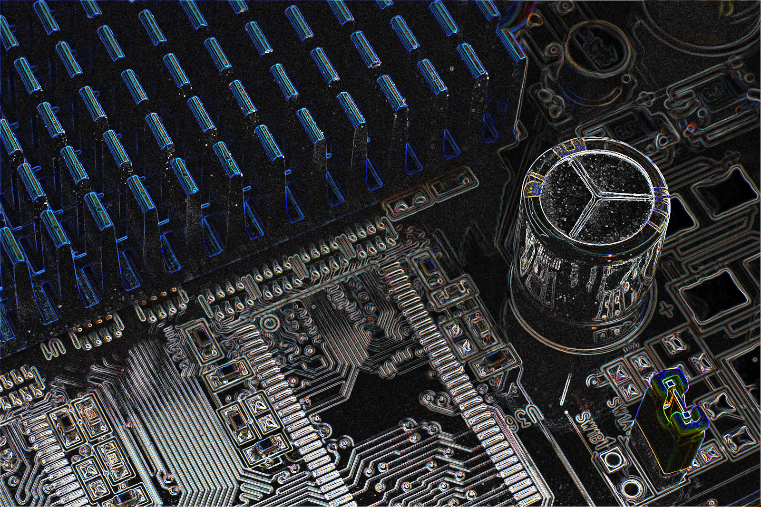
Sample Result

Slide 25
Preparation
TA provided CPU version, Makefile, and hint
Files are located at /home/pp24/share/lab-sobel
Please do not copy the testcases
sobel.cu is cpu version(you need to rewrite it with cuda!)
Follow hints
After you finish the code using CUDA, try it on AMD GPU

Slide 26
Workflow
cp -r /home/pp24/share/lab-sobel ~/lab_sobel
module load rocm cuda
Finish the hints
Compile the program : make sobel
Run the program : srun --gres=gpu:1 ./sobel testcases/candy.png candy.out.png
Check the diff : png-diff testcases/candy.out.png candy.out.png
Judge: lab-sobel-judge
Scoreboard: sobel

Slide 27
Workflow for AMD GPU
We ask you to test your code on AMD GPU as well.
No need to rewrite the code, just use “Hipify”
module load rocm cuda
Hipify your CUDA code: hipify-clang sobel.cu Generates sobel.cu.hip
Inspect the code and learn how HIP works
Rename the file to sobel.hip
Compile the program make sobel-amd
Run : srun -p amd --gres=gpu:1 ./sobel-amd testcases/candy.png candy.out.png
Judge: lab-sobel-amd-judge
Scoreboard: sobel-amd

Slide 28
How to run
apollo-nv-test
./sobel <input> <output>
CUDA_VISIBLE_DEVICES=0 ./sobel <input> <output>
apollo-nv-vm[1-7]
srun -n 1 --gres=gpu:1 ./sobel <input> <output>
apollo-amd-vm
srun -p amd -n 1 --gres=gpu:1 ./sobel-hip <input> <output>

Slide 29
Check the correctness
png-diff <result_file> <answer_file>
It verifies the correctness of your output result
result_file is the output file from your CUDA program.
answer_file is the provided file for correctness checking.
If your input_file is “~/lab_sobel/testcases/candy.png” , your answer_file is “~/lab_sobel/testcases/candy.out.png”
Your code is correct if you see “ok, 100.00%”

Slide 30
Hints
Malloc memory on GPU
Copy the original image to GPU
Put filter matrix on device memory (or declare it on device)
Parallelize the sobel computing
Copy the results from device to host
Free unused address

Slide 31
Submission
Judge will execute your code with single process, single GPU
Submit your code and Makefile (optional) to eeclass before 10/31 23:59
Use lab-sobel and lab-sobel-amd to judge
Get started as soon as possible to avoid heavy queueing delay
sobel.cu
sobel.hip
Makefile (Optional)

